Slide 1
SOSYAL BİLİMLERDE UYGULAMALI ANALİZ TEKNİKLERİ
Ümit Çağrı
17D20415855
Aralık 2014

Slide 2
SKEWNESS ( ÇARPIKLIK) & KURTOSIS (BASIKLIK)

Slide 3
Normal probability curve

Slide 4
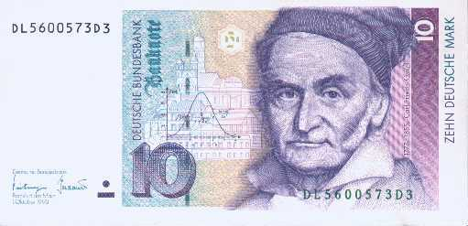
Carl Gauss
The normal probability distribution or the “normal curve” is often called the Gaussian distribution,

Slide 5
Bell shaped curve
The shape of the curve is like that of a bell.

Slide 6
Mean = median = mode
Mean, median and mode carry the equal value.
Therefore they fall at the same point on the curve

Slide 7
Perfectly symmetricality
It means the curve inclines towards both sides equally from the centre of the curve.
Thus we get equal halves on both sides from the central point.
The curve is not skewed. Therefore the values of the measure of skewness is zero

Slide 8
Each of the two shaded areas is .5 or 50%
.5
.5

Slide 9
Properties of the Normal Curve
Bell-shaped
Unimodal
mean = median = mode
Symmetrical
Tails are asymptotic

Slide 10
Skewness
Skewness means asymmetrial nature.
When the curve on clones towards right or left we cannot take it as a normal curve but as a skewed curve.
The degree of departure from symmetry is called symmetry.

Slide 11
Skewness
Positive Skewness: Mean ≥ Median
Negative Skewness: Median ≥ Mean

Slide 12
Negative
When the curve inclines more to the left skewness becomes negative
mean
median
mode
Negative or Left Skew Distribution

Slide 13
Positive
When the curve inclines more towards right
mode
median
mean
Positive or Right Skew Distribution

Slide 14
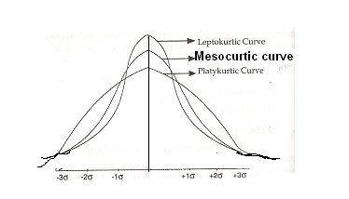
Kurtosis
Literally kurtosis means tendency of ‘flatness’ or ‘peakedness’.
The normal curve is moderately peaked.

Slide 15
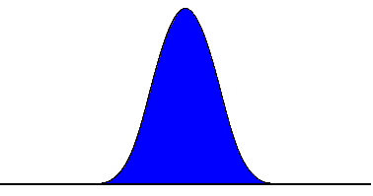
Kurtosis: the proportion of a curve located in the center, shoulders and tails
How fat or thin the tails are
leptokurtic
no shoulders
platykurtic
wide shoulders

Slide 16
Platy kurtoc
When the curve is more flattened the distribution will be called as platy kurtoc

Slide 17
Lepto kurtoc
When the curve is more peaked than normal one it is called as lepto kurtoc curve

Slide 18
Reasons for divergence from normality
Biased selection of sample
Scoring errors
Improper construction of a test
Improper administration of a test
Abnormality in the traits of the items.

Slide 19
SKEWNESS & KURTOSIS IN SPSS

